Slide 1
Prescribing Assessment
RCGP WPBA trainee induction presentation
2024 update

Slide 2
Prescribing assessment - Introduction
Self-assessment prescribing review for GP trainees set up in conjunction with Nottingham university
Based on PRACtICe study and REVIST study
Prescribing errors found in 1/20 prescriptions
Prescribing integral part of GP work
Over one billion prescription items issued each year
To date not formally assessed
Agreed that trainees would benefit from support in prescribing

Slide 3
Practicalities of assessment
To be completed in first half of GP ST3 year
In addition to other ST3 assessments but reducing total number of other assessments in ST3 year
Formative tool, mandatory to complete
Only fail if not completed, no set standard required
Will form part of the data within the Portfolio on which a summative judgment will be made of the trainees progression

Slide 4
Definition of prescribing error
A prescribing error occurs when, as a result of a prescribing decision or prescription-writing process, there is an unintentional, significant reduction in the probability of treatment being timely and effective, or increase in the risk of harm when compared to generally accepted practice.

Slide 5
Other definitions
Suboptimal prescribing:
These are prescribing problems that do not fit the above error definitions but represent less than ideal practice
Legal errors:
Where a prescription has not met the legal requirements for prescribing
  E.g. written for wrong patient name

Slide 6
What the review is intended to do
Review prescribing in a sample of prescriptions
Be an educational intervention that will highlight areas of prescribing that could be improved to reduce the risk of harm
Improve communication with patients and those dispensing medication
Encourage reflection and development of good prescribing habits that will protect against errors in long term
Confirm good prescribing practice

Slide 7
What the review is NOT intended to do
Review the diagnosis within a consultation
Set the expectation that all prescribing undertaken in the review must be perfect
Dishearten or discourage the reviewer
Review prescribing primarily on the grounds of cost

Slide 8
What is assessed?
Reflection and learning
An acceptable error rate is not set, numbers are for comparison and context
It is not the rate of errors that is important but how you the trainee responds to them
An assessment with no errors and no learning would not be acceptable, as this was never the case in either the PRACtICe or REVISIT study

Slide 9
Trainee reviews all consultations backwards from set date trainer gives to identify last 50 scripts issued or computer search may be used
Start of data collection period will be chosen by clinical supervisor
Trainee reviews the 50 prescriptions in the spread sheet
Any issues highlighted are investigated
Identify possible causes and methods of avoidance
Trainee will not know the start date in advance
Trainer will review at least 20 prescription items, including those where the trainee has not identified errors
Trainee will write up findings and reflections in trainee prescribing assessment log in the Portfolio and create PDP entries where appropriate
Tutorial with ES, CS or Pharmacist
Trainer will complete prescribing assessment form and comment on the review and suggested entries for the PDP, editing and suggesting additional entries if required.
Trainer makes assessment of trainees prescribing at this stage.
To discuss results and agree the next steps
Agree the error avoidance strategies to embed into practice
Data added to trainee spread sheet

Slide 10
The trainee review - preparation
Retrospective to capture normal prescribing habits
Either manual review records from date set by supervisor until 50 prescriptions reviewed; or
Computer generated search added to spread sheet of 50 consecutive prescriptions

Slide 11
How to assess:
Was the RIGHT DRUG (s) selected for the indication and the patient?
Was the drug prescribed at the RIGHT DOSE for the indication and the patient?
Were the RIGHT DOSAGE INSTRUCTIONS written on the prescription in a way the patient can understand?
Was the RIGHT FOLLOW UP planned, enacted or acted upon with regards to the medication?
Have you provided the RIGHT DOCUMENTATION to support prescribing?
Has the medication been subject to the RIGHT REVIEW before prescribing (including checking adherence to therapy)?
Are there any examples of GOOD PRESCRIBING practice?

Slide 12
How to assess:
Was the RIGHT DRUG (s) selected for the indication and the patient? Is this drug suggested by NICE or other guidelines as first choice; are there good reasons to use it if it is second choice? Have allergies or contraindications been considered?
Was the drug prescribed at the RIGHT DOSE for the indication and the patient? E.g. is the dose the one advised by BNF bearing in mind LFT and renal function?
Were the RIGHT DOSAGE INSTRUCTIONS written on the prescription in a way the patient can understand? They should be in plain English (not qid or qds) and should be specific (as needed is never appropriate; which eye or ear should be stated.)
Was the RIGHT FOLLOW UP planned, enacted or acted upon with regards to the medication? E.g. if there should be a review of blood tests were these arranged; were arrangements made for review of a trial of treatment ? Etc.
Notes:
Right Drug
Evidence for use in the indication
Allergies
Contra-indications/Cautions
Interactions with co-prescribed medication
Local and national prescribing guidelines
Local formulary
Social issues (e.g. carers, inclusion in a monitored dosage system)
Formulation
Duplication or omissions in therapy.
Correct use of brand prescribing for safety reasons
Right Dose
Renal or hepatic function
Age / weight
Local and national prescribing guidance (including MHRA)
Is the dose correct for the indication?
Has increasing or reducing dosing been done appropriately?
Most appropriate strength of tablet prescribed for the required dose.
Right Dosage Instructions
Clear and unambiguous (avoiding “as directed”)
Up to date (with current usage/latest letters from secondary care)
Include route of administration/area of application/treatment eye or ear
Are the instructions able to be read and understood by the patient?
Right follow up
Has the necessary monitoring has been planned/taken/acted upon e.g. blood tests, BP.
Has the item been placed on repeat appropriately so that it cannot be continued without a necessary review?

Slide 13
How to Assess part 2
Have you provided the RIGHT DOCUMENTATION to support prescribing? Does the documentation make the indication, monitoring and follow up clear; If prescribing does not follow normal guidance is the reason documented?
Has the medication been subject to the RIGHT REVIEW before prescribing (including checking adherence to therapy)? Have any necessary discussions taken place before continuing medications with risks e.g. HRT?
Are there any examples of GOOD PRESCRIBING practice? E.g. following guidelines, clear explanations, clear details on OTC suggestions
Notes:
Right Documentation
Is the indication for prescribing clear?
If prescribing does not follow normal guidance is the reason documented?
Is the plan for any necessary monitoring or follow up documented?
Right Review
Where the medication has been used before, has under or over-ordering been addressed before supplying (adherence to therapy)?
Have any necessary discussions taken place before continuing medications with risks e.g. HRT?
Good prescribing
Does prescribing show that local guidelines have been referred to e.g. antimicrobial guidelines?
Is the prescribing plan in the notes and thought process accurate and clear for the next clinician to follow?
Is the OTC advice that has been given very clear with regards to medication dosage and further advice?

Slide 14
Errors
More than one type can apply to a single prescription
Trainee should consider possible reasons why and how to avoid in future
Good practice should make conscious decision to continue
Look for themes and patterns
If significant error this should be highlighted to the supervisor and follow practice procedures

Slide 15
Preparing for the review
Have available reference sources:
  BNF and BNF for children
  Local formulary guidance
  Local clinical guidelines e.g. antimicrobial
  The ‘Self- assessment Prescribing review for GP trainees’ document

Slide 16
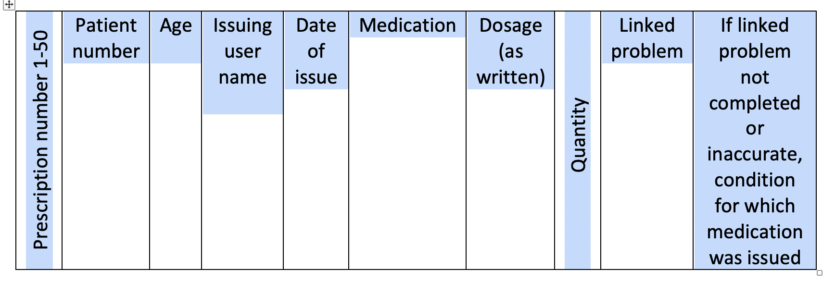
Excel spreadsheet - part 1

Slide 17
Excel spreadsheet - part 2

Slide 18
Excel spreadsheet part 3
Records reflections on possible reasons the issue occurred
Asks about possible strategies that could be used in future to prevent issue occurring again
This section is essential
Numbers alone are not acceptable

Slide 19
GP Prescribing proficiencies
The trainee needs to self assess and to reflect on their performance against the GP prescribing proficiencies
The supervisor needs to assess the trainee against the same proficiencies

Slide 20
GP Prescribing proficiencies
Assess the risks and benefits including that posed by other medications and medical conditions.
Identify when prescribing unlicensed medicines and informs patients appropriately.
Adhere to local guidelines and evidence based medicine.
Use antimicrobials appropriately.
Counsel patients appropriately including instructions for taking medicines safely in line with up to date literature.
Review and monitor effects including blood testing at appropriate intervals
Range of ages and clinical areas covered in assessment
Notes:
The GMC now require a trainee to demonstrate competence in prescribing. The requirements that they require are listed above. We used these to devise an assessment to try and review this.

Slide 21
GP Prescribing proficiencies – Continued
Prescribe medicine or treatment, including repeat prescriptions, only when you have adequate knowledge of the patient’s health, and are satisfied that the medicine or treatment serve the patient’s needs.
Provide effective treatments based on the best available evidence.
Check that the care or treatment you provide for each patient is compatible with any other treatments the patient is receiving, including where possible self-prescribed over-the-counter medications.
(in prescribing) You must make good use of the resources available to you.
Documents you make to formally record your work, including clinical records, must be clear, accurate and legible. You should make records at the same time as the events you are recording or as soon as possible afterwards. They should include any drugs prescribed or other investigation or treatment.
Notes:
The GMC now require a trainee to demonstrate competence in prescribing. The requirements that they require are listed above. We used these to devise an assessment to try and review this.

Slide 22
Analysing the results
How many prescribing events have been highlighted by you?
Were there any themes that could be identified within these prescribing events?
Which areas of good prescribing did your review identify?
What was the number of prescribing events in each of the prescription categories (new repeat, repeat repeat etc.)?
What was the number of prescribing events in each of the prescribing event categories (right drug, right dose etc.)?
Are there any prescribing events that have occurred more than once (e.g. incorrect dose of an antibiotic)?
Are there examples of good prescribing that have occurred more than once?
When the possible reasons and possible strategies for the future are considered are there recurring themes e.g. need to refer to guidelines, need to document indication. How can this then link to your personal development plan?
Which areas of the BNF cover the majority of the prescribing (e.g. antimicrobial and analgesia)? Would your clinical supervisor consider this typical of current prescribing and that of a post CCT GP?

Slide 23
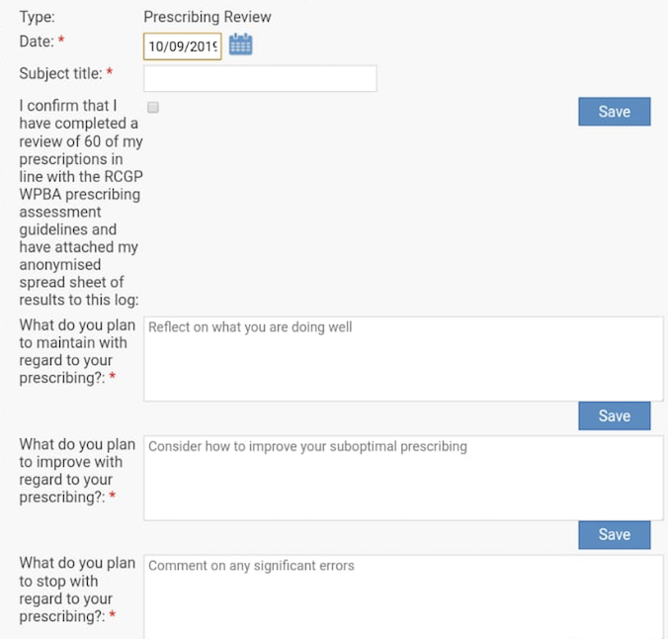
Trainee completes reflection form – part 1

Slide 24
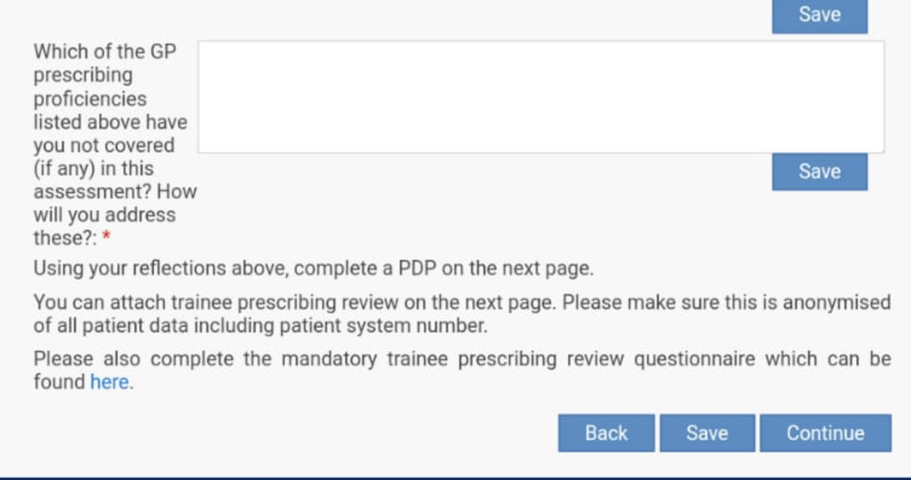
Trainee completes reflection form – part 2

Slide 25
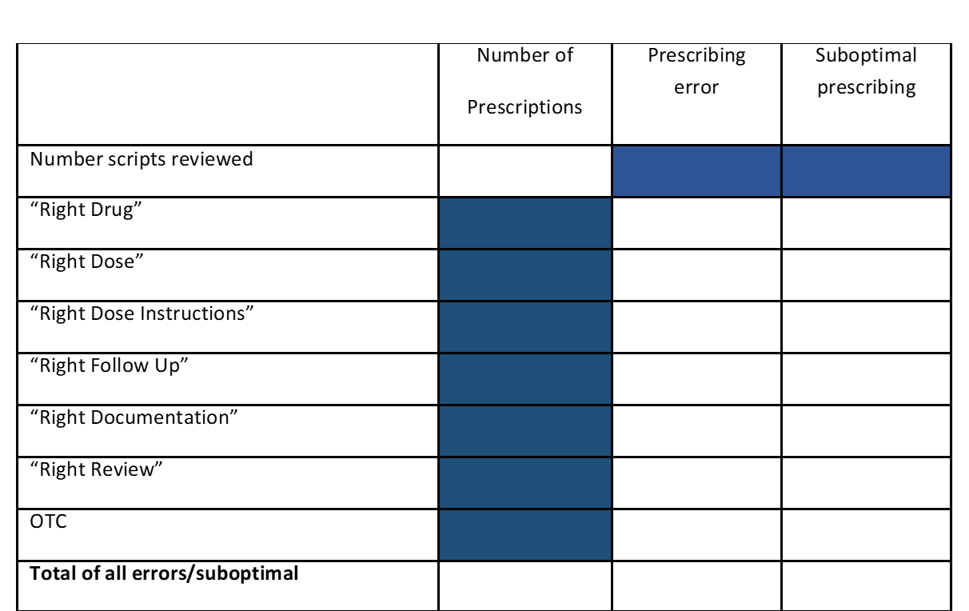
Trainee completes prescribing reflection form

Slide 26
Trainee prescribing reflection form
Prescribing trainee assessment reflection
I confirm that I have completed a review of 50 of my prescriptions in line with the RCGP WPBA prescribing assessment guidelines and have attached my spread sheet of results to this log*
Reflect with reference to the GP Prescribing Proficiencies outlined above.
What do you plan to maintain with regard to your prescribing?*
[Reflect on what you are doing well]
What do you plan to improve with regard to your prescribing?*
[Consider how to improve your suboptimal prescribing]
What do you plan to stop with regard to your prescribing?*
[Comment on any significant errors]

Slide 27
Trainee prescribing reflection form continued
Prescribing trainee assessment reflection
Which of the GP prescribing skills listed above have you not covered (if any) in this assessment? How will you address these?*
Using your reflections above complete the following PDP(s):* [creates a mandatory draft PDP entry which trainer will review]
Learning Objectives:
Target Date:
Action plan:
How will I know when it is achieved?:
[Request generation of second PDP as required]

Slide 28
Evidence forms
Trainee needs to complete a new learning log type “prescribing assessment” and attach:
  Excel spreadsheet – having removed any identifiable ID numbers
The trainer will complete a new Prescribing assessment form

Slide 29
Additional information
Right Drug
Evidence for use in the indication
Allergies
Contra-indications/Cautions
Interactions with co-prescribed medication
Local and national prescribing guidelines
Local formulary
Social issues (e.g. carers, inclusion in a monitored dosage system)
Formulation
Duplication or omissions in therapy.
Correct use of brand prescribing for safety reasons

Slide 30
Additional information
Right Dose
Renal or hepatic function
Age / weight
Local and national prescribing guidance (including MHRA)
Is the dose correct for the indication?
Has increasing or reducing dosing been done appropriately?
Most appropriate strength of tablet prescribed for the required dose.

Slide 31
Additional information
Right Dosage Instructions
Clear and unambiguous (avoiding “as directed”)
Up to date (with current usage/latest letters from secondary care)
Include route of administration/area of application/treatment eye or ear
Are the instructions able to be read and understood by the patient?
Right follow up
Has the necessary monitoring has been planned/taken/acted upon e.g. blood tests, BP?
Has the item been placed on repeat appropriately so that it cannot be continued without a necessary review?

Slide 32
Additional information
Right Documentation
Is the indication for prescribing clear?
If prescribing does not follow normal guidance is the reason documented?
Is the plan for any necessary monitoring or follow up documented?
Right Review
Where the medication has been used before, has under or over-ordering been addressed before supplying (adherence to therapy)?
Have any necessary discussions taken place before continuing medications with risks e.g. HRT?

Slide 33
Additional information
Good prescribing
Does prescribing show that local guidelines have been referred to e.g. antimicrobial guidelines?
Is the prescribing plan in the notes and thought process accurate and clear for the next clinician to follow?
Is the OTC advice that has been given very clear with regards to medication dosage and further advice?

Slide 34
Prescribing assessment -1st half ST3
Summary
Trainee searches /downloads 50 retrospective scripts they have initiated
Reviews 50 against prescribing errors manual – right drug, dose, dosage frequency, documentation, follow up.
Trainee reflection on the assessment via prescribing assessment log entry
Completes table mapping their prescribing to errors
Supervisor, (possibly pharmacist if available), samples 20 of scripts, including those where the trainee did not identify any errors and uses the records, local and national guidance and the prescribing manual to assess them in the same way as the trainee
Trainer completes new prescribing assessment form
Formative feedback is provided reviewing any significant errors, learning plans and any proficiencies or patient types not covered
Notes:
We were fortunate that Nottingham Uni had recently completed a study looking at prescribing in qualified GPs. We used their research and further evaluation from us to come up with the assessment above.

Slide 35
Link(s) to explanatory video
https://youtu.be/sHtVmX0KnCQ
https://www.rcgp.org.uk/training-exams/training/mrcgp-workplace-based-assessment-wpba/prescribing.aspx

Slide 36
Any Questions?

