Slide 1
New Learning Logs
and Assessments

Slide 2
WPBA
WPBA evaluates the trainee's progress in areas of professional practice best tested in the workplace and:
Looks at trainees performance in their day to day practice provides evidence for learning and reflection on performance
Supports and drives learning in important areas of competence with an underlying theme of patient safety
Provides constructive feedback on areas of strength and developmental needs, identifying trainees who may be in difficulty
Evaluates aspects of professional behaviour that are difficult to assess in traditional examinations
Determines fitness to progress to the next stage of training

Slide 3
New WPBA programme
New Learning Log Types
New Assessments – Quality Improvement, Prescribing, Leadership, Care Assessment Tool (CAT)
Updated existing assessments, reports and reviews
Mandatory requirements remain –annual child and adult safeguarding, (if child post), Basic life Support and AED
Notes:
One ESR annually and shorter interim year review if trainee progressing well.
Reduced number of Cbds , COTs
Reduced number of logs
PSQ only in ST3

Slide 4
Clinical Experience Groups
1. Infants, children and young people [under the age of 19yrs]
2. Gender, reproductive and sexual health (including women’s, men’s, LGBTQ, gynaecology and breast)
3. People with long-term conditions including cancer, multi-morbidity and disability
4. Older adults including frailty and/or people at end of life
5. Mental health (including addiction, alcohol and substance misuse)
6. Urgent and unscheduled care
7. People with health disadvantage and vulnerabilities (including veterans, mental capacity difficulties, safeguarding and those with communication difficulties/disability)
8. Population Health and health promotion (including people with non-acute and/or
non-chronic health problems)
9. Clinical problems not linked to a specific clinical experience group
Notes:
Role of clinical experience groups rather than individual curriculum areas –becomes less tick box like –all mapped to curriculum.
Trainee links to learning logs, supervisors link to assessments

Slide 5
Capabilities
13 Competences renamed as Capabilities
Same 13 areas except Holistic care now also includes safeguarding
Trainees will also link their log entries to capabilities and document why they have covered this capability
Increase trainee understanding of capabilities
ES will be able to comment on each capability which they can subsequently move into their ESR preparation
Word Pictures to support all the capabilities for each grade

Slide 6
Capabilities
Fitness to Practice
Maintaining an ethical approach
Communication and Consultation Skills
Data Gathering and Interpretation
Clinical Examination and Procedural Skills
Making a diagnosis /decisions
Clinical management
Managing medical complexity
Working with colleagues and in teams
Maintaining performance, learning and teaching
Organisation, Management and leadership
Practising Holistically, Promoting health and safeguarding
Community orientation

Slide 7
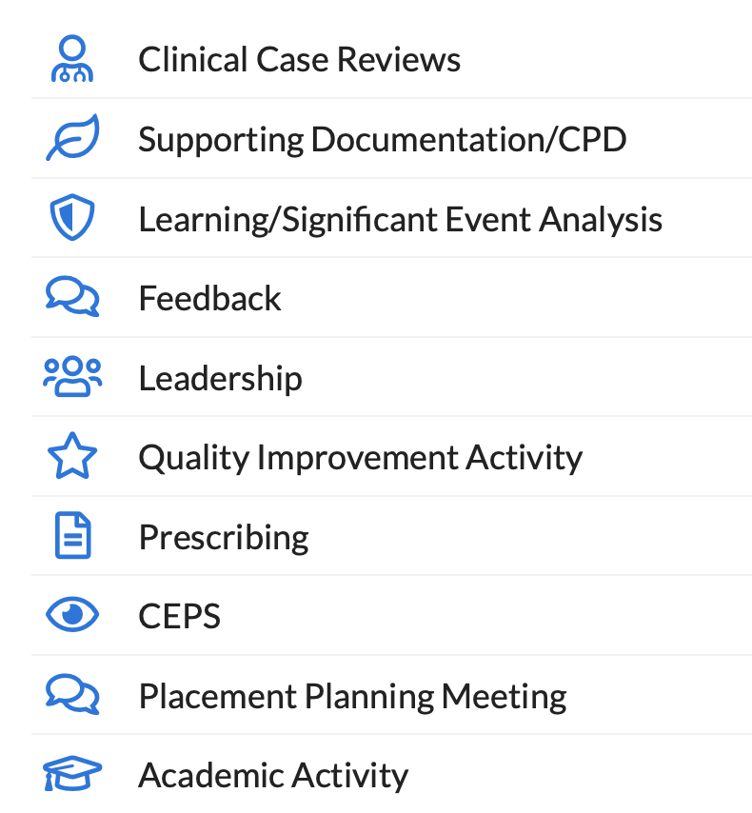
New Learning Log Types

Slide 8
Clinical case review
Title, Date and Setting
Brief description
List of clinical experience groups to choose from: (max 2)
Suggested capability: (max 3)
Describe how your actions and approach link to the capability listed above?
Reflection: what will I maintain, improve or stop?
What learning needs have you identified from this event?
Notes:
This is what a clinical case review will look like. This will be the most common type of learning log likely accounting for about 50% of logs.
As you will see, the trainee will be selecting their capabilities. The ES can add or remove both capabilities and clinical experience groups. Where the star is above, this the text that the trainee can use to auto-populate their self rating for the ESR. When you review the log as an ES, you can add narrative to each of the capabilities and then you yourself, can use this narrative to autopopulate your ESR.

Slide 9
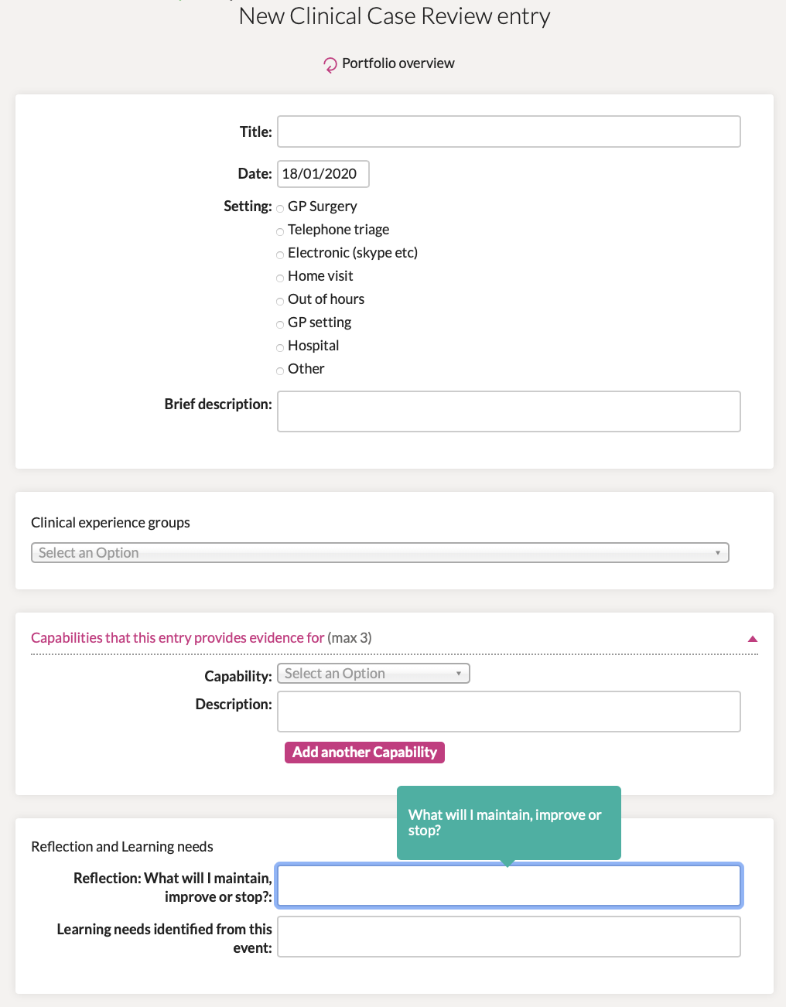
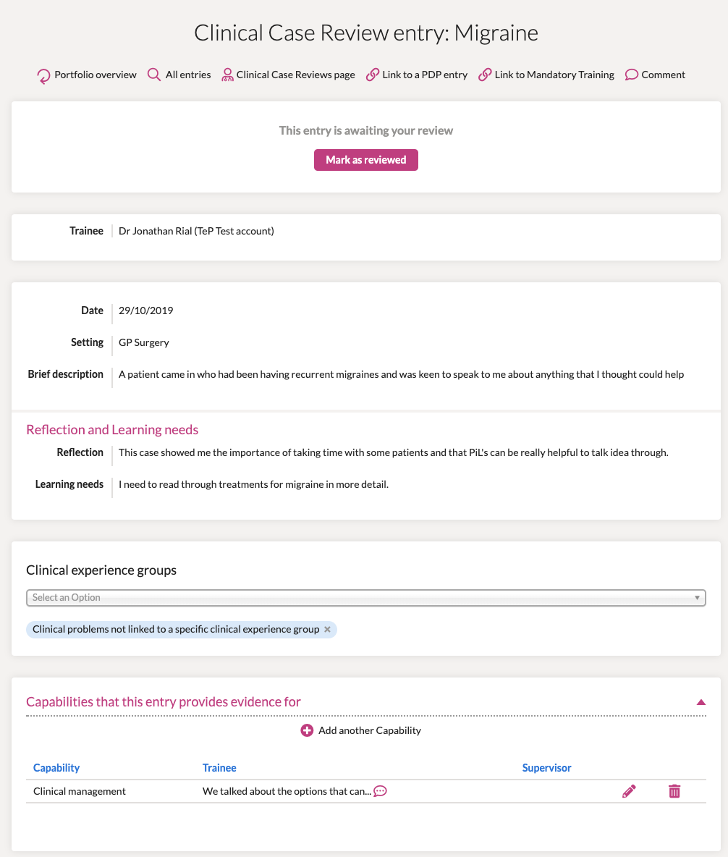
Notes:
On the left is how it looks for the trainee, on the right, how it looks for the ES. You can see that the ES can add capabilities, comment on those already added by the trainee but can also comment ‘this is for generic comments rather than capability specific’. Both trainee and ES can link the log to a PDP or mandatory training, such as BLS.

Slide 10
Supporting Documentation CPD
Title, Date
Describe your key learning from this event briefly [this could include helping you to maintain existing knowledge and skills]
Reflection: what will I maintain, improve or stop?
What learning needs have you identified from this event?
Suggested clinical experience groups
Suggested capabilities with evidence for this
Notes:
This is the new supporting documentation log questions. You will note that the initial questions don’t ask about capabilities but the trainee has the option to add these at the end should they wish. Again, they have the option to add narrative at this point which can be pulled through to the ESR self rating

Slide 11
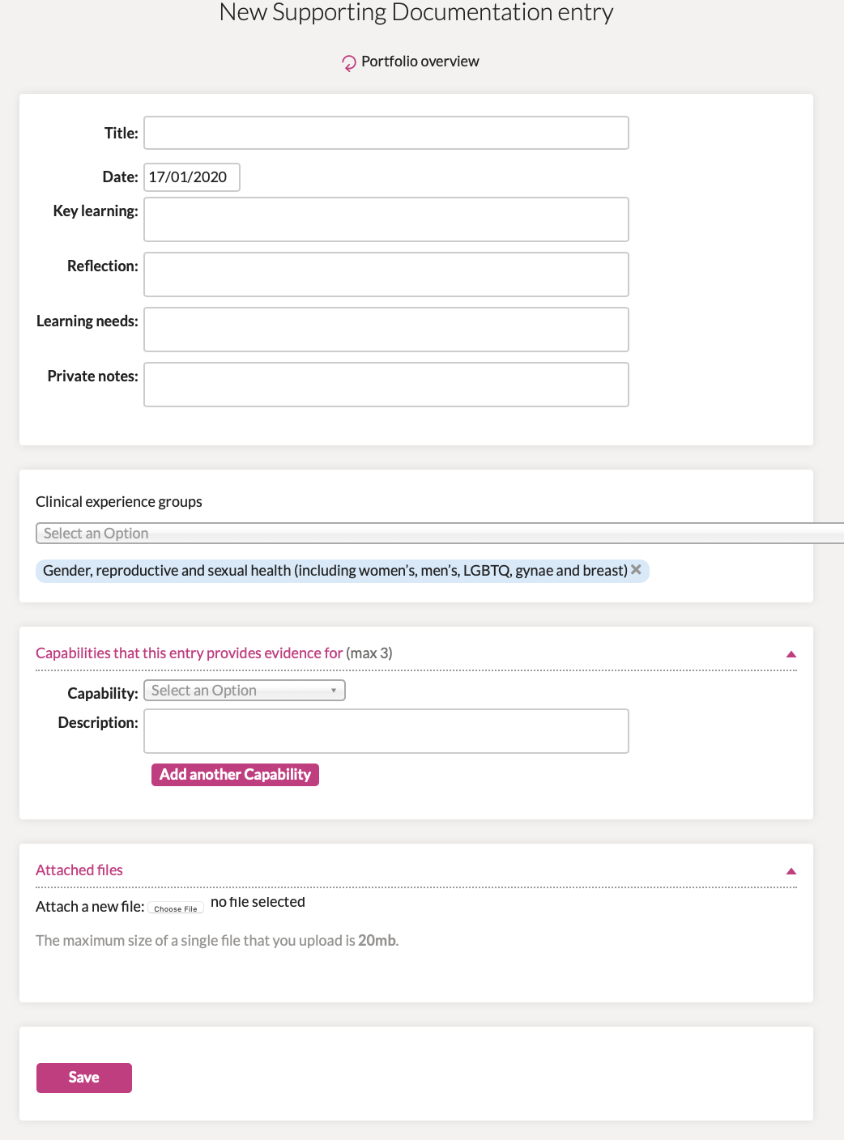

Slide 12
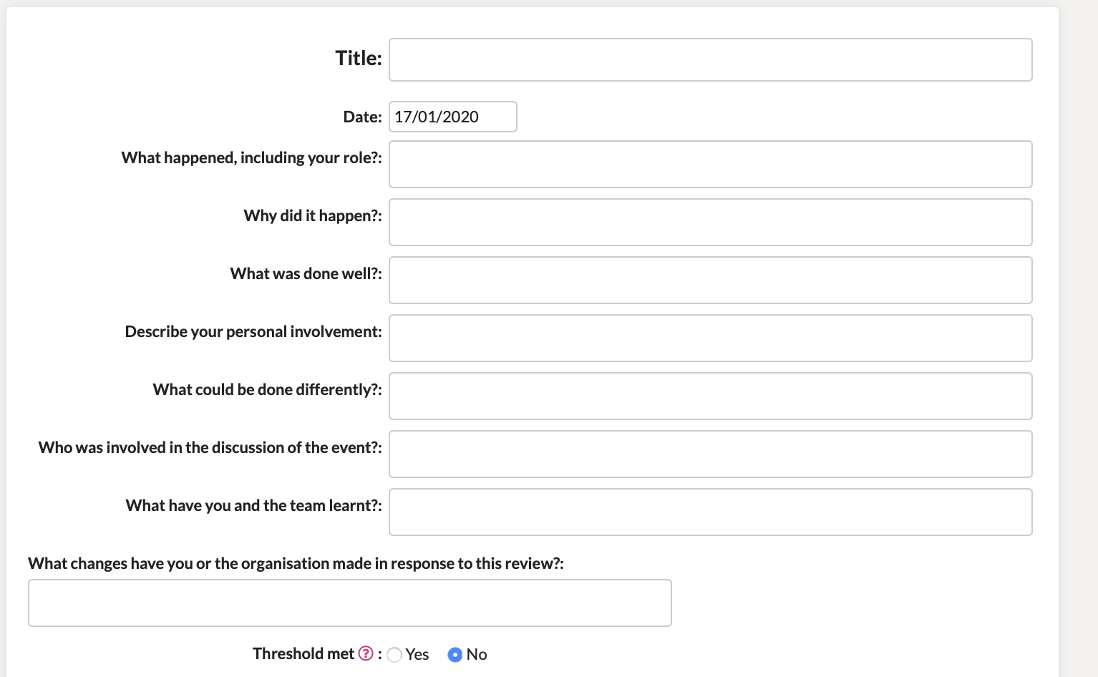
Learning/Significant Event Analysis
Notes:
This is what the new Learning/significant event log will look like. You can see there are several mandatory questions which are similar to standard SEA qustions. At the bottom you will note the question ‘threshold met’, this refers to whether the patient was at risk or harm or did come to harm as per GMC guidance. This is what triggers the trainee having to add this event to their Form R. If they click no then they can add the capabilities as normal, however, if they click yes, a couple of extra boxes will come up.

Slide 13
Notes:
The wording which appears if you click the icon is from the Form R and the boxes at the bottom right are the extra boxes that appear should ‘threshold met’ be ticked.

Slide 14
Title, Date
Brief description
How does this feedback make you feel?
What are your key learning points?
Reflection: what will I maintain, improve or stop?
What support have you had or require?
Have you taken your plans to your PDP? How will you re-assess/monitor improvements?
Suggested capabilities (max. 3)
Feedback

Slide 15
Assessments

Slide 16
Assessment Ratings
Non- primary care
Significantly below expectations
Below expectations
Meets expectations
Above expectations
Primary care
NFD- below expectations
NFD- meeting expectations
Competent
Excellent
Notes:
We have simplified the ratings for all of the assessments and. Aimed for some consistency.
We have stopped asking those who are not in primary care to comment on whether a trainee is competent to be a GP
Non-primary care rated against peer
Primary care rated against finishing ST3 trainee

Slide 17
Assessment of Performance
Assessor also asked if assessment was:
Below level expected prior to starting GP training
Below level expected of a GP trainee working in this post
At level expected of a G trainee working in this post
Above the level of a GP trainee working in this post
Increases reliability of assessment
Notes:
Assessment of Performance for all assessments

Slide 18
QIP
NEW
UNCHANGED
Assessments
Leadership
activity and MSF
Prescribing
QIP
CAT
MSF
Audio-COT
UPDATED
CbD
COT
PSQ
CSR
CEPS
Mini-CEX
Notes:
CEPS – Added assessment of Performance,
COT – Added assessment of Performance
Mini-CEX – is shorter and have added assessment of Performance
PSQ – New Questions, shorter and self rating required

Slide 19
A structured oral interview to assess your professional judgment.
Assesses performance against capabilities
Case based Discussion CbD
(when not in primary care)
Title
Brief Description
Level of Complexity
Clinical Experience Groups
Capability (select up to 4)
Grade against Expectations (significantly below, below, meets, above)
Feedback on performance and justification for grade
Recommendations for future development in that capability
Assessment of Performance
Below level expected prior to starting GP Training
Below level expected of GP trainee working in this post
At the level expected of GP trainee working in this post
Above the level expected of GP trainee working in this post
Agreed action

Slide 20
Same format as CbD but can cover other areas
Care Assessment Tool
Choose which type of CAT:
Case Based Discussion
Post prescribing assessment follow up review
Random case review
Referrals review
Other (please specify)
Graded as NFD below expectations, NFD meets expectations, competent, excellent compared to competent GP
Assessment of Performance
Below level expected prior to starting GP Training
Below level expected of GP trainee working in this post
At the level expected of GP trainee working in this post
Above the level expected of GP trainee working in this post
Observation and feedback on performance
Agreed action plan

Slide 21
MiniCEX
Assessed real life interaction between you and a patient in non-primary care
Title
Brief Description
Level of Complexity
Clinical Experience Groups
Covers Professionalism, Communication and consultation skills,
Clinical assessment and management, organisation and efficiency
Graded against Expectations (significantly below, below, meets, above)
in comparison to peers
Assessment of Performance
Below level expected prior to starting GP Training
Below level expected of GP trainee working in this post
At the level expected of GP trainee working in this post
Above the level expected of GP trainee working in this post
Agreed action plan

Slide 22
Assessed real life interaction between you and a patient either face to face or on the telephone
COT /AudioCOT
Title
Brief Description
Level of Complexity
Clinical Experience Groups
Covers up to 14 areas within a GP consultation
Graded as NFD below expectations, NFD meets expectations, competent ,
excellent compared to competent GP
Assessment of Performance
Below level expected prior to starting GP Training
Below level expected of GP trainee working in this post
At the level expected of GP trainee working in this post
Above the level expected of GP trainee working in this post
Observation and feedback on performance
Agreed action plan

Slide 23
Clinical Examination and
Procedural Skills
Assesses your ability to examine competently
1. Evidence of 5 mandatory intimate examinations and
2. Range of Clinical Examination and Procedural skills relevant to General Practice
Mandatory examinations must be assessed and assessment form completed.
Assessment needs to support a competent and safe performance or will need to be repeated
Covers communication, awareness of cultural and ethical factors, ability to perform the skill
and consideration of patient
Range of other skills can be assessed and/or documented in learning log, MiniCEX or
COT assessments

Slide 24
Multi-Source Feedback and
Patient Satisfaction Questionnaires
MSF &
PSQ
MSF used to collect your colleagues opinions on your clinical and professional behaviour
Completed every year and minimum of 10 replies – ideally 5 clinical and 5 non-clinical
In ST3 a leadership MSF is also required
PSQ – Completed in ST3
Patient feedback on your empathy and relationship building skills during consultations
Patients are asked to rate you against 9 questions

Slide 25
Short structured report completed by your CS at end of each post
Clinical Supervisors Report CSR
Opportunity to receive feedback on you performance
Covers 7 areas
Linked to capabilities
Summary of your supervisors observations during that post
Each area rated against expectations (significantly below, below, meets, above)
in comparison to peers
CS also makes an assessment of the level of supervision required in that post
CSR required for all Non-primary care posts and in primary care posts if CS different from ES,
missing information in Portfolio and CSR would fill this gap, either CS or trainee request this
to be done

Slide 26
ESR/ Interim ESR
All trainees have to have an annual ESR
An interim ESR can be completed at the 6 month point of training if trainee progressing
well, if not will need full ESR
Trainee completes self assessment of all 13 capabilities, using linked evidence from
learning logs, assessments and CSRs
Completes 3 action plans linked to 3 capabilities you want to improve before next review
Adds PDP entry if not already done and relates this to learning in next 6 months
Supervisor equally rates and documents evidence against 13 capabilities
Comments on quality of reflection, PDP, CEPS
Gives overall outcome on progression

Slide 27
Quality Improvement Project
Use data to identify areas for improvement
Critically appraise information
Deploy quality improvement methods –eg plan do study act and repeat quality improvement cycles to refine practice
Involves patients
Engage with stakeholders
Evaluate the impact of quality improvement interventions
Template developed for trainee to write up QIP
Word pictures for supervisor to assess
NFD -below, NFD meets or NFD above expectation for each area
Training resources for VTS schemes, completed QIPS and marked examples, suggested list of ideas on RCGP website
Looks at the quality of care provided with the aim to improve it

Slide 28
Prescribing
GMC introduced prescribing proficiencies which all trainees have to meet
Trainee searches /downloads 50 retrospective scripts they have initiated
Reviews 50 against prescribing errors manual – right drug, dose, dosage frequency, documentation, follow up using consultation record
Trainee reflects on the assessment via log entry
Completes table mapping their prescribing to errors
Supervisor, (possibly pharmacist if available), samples 20 of scripts, to include any with identified errors
Supervisor completes assessment form after tutorial
Formative prescribing assessment on your actual prescribing

Slide 29
Leadership
To understand why leadership is important, appreciate your leadership style and its impact
2 requirements
Complete a leadership activity and document this in your learning log
Examples
Chairing a meeting
Fresh pair of eyes.
Practice leaflet project.
Clinical protocol.
Website design
Wellbeing project
2. Complete leadership MSF. Respondents rate your leadership skills against 5 areas
Training resources available on RCGP website

Slide 30
ST1 and ST2 in each year WPBA requirements
4 mini-CEX and 4 CbDs (1 assessment to be done by Clinical Supervisor completing CSR)
MSF in both ST1 and ST2 – 10 replies each time
CSR at end of every placement (see guidance re CSR in primary care posts)
CEPS Clinical Examination and Procedural Skills as currently
QI project (QIP) - Primary care placement ST1or ST2- assessed by ES
Involvement in audit /QIA in year when not doing QIP

Slide 31
ST1 and ST2 in each year WPBA requirements
Case reviews - clinical encounters in learning log to be replaced with case reviews -3 /month (FTE)
Linked to clinical experience groups and capabilities
Shorter log templates to complete
Placement planning meeting in log for each post as currently
Annual ESR
Interim Mid year review- light touch
Personal Development Plan as currently
Learning event analysis
Significant event analysis if relevant

Slide 32
ST3 - WPBA requirements
7 COTs /AudioCOTs
5 Case Assessment Tools (including) Cbds
Prescribing assessment
Leadership activity
MSF in 1st 6 months / leadership MSF in 2nd half of ST3 (after leadership activity)
PSQ
3 case reviews/month in learning log
Involvement in practice QI/ audit
ESR annually and interim review
Child /adult safeguarding / BLS / PDP/ LEA/SEA/CEPS

Slide 33
WPBA numbers for each year of training
 | ST1 | ST2 | ST3
Mini-CEX/COT | 4 | 4 | 7
Any setting (face to face, telephone, or video)
CBD / CAT | 4 CbD | 4 CbD | 5 CAT
MSF | 1 (with 10 responses) | 1 (with 10 responses) | 2 (1 MSF, 1 Leadership MSF)
CSR | 1 per post* | 1 per post* | 1 per post*
PSQ | 0 | 0 | 1
CEPS | Ongoing | Ongoing | Across 3 years
 |  |  | 5 intimate plus a range of others
Learning Logs | 36 Case Reviews | 36 Case reviews | 36 Case Reviews
Placement Planning Meeting | 1 per post | 1 per post | 1 per post
QIP | 1 (in GP post) | 1 (in GP post) – if not done in ST1 | 0
Quality Improvement Activity | All trainees must demonstrate involvement in Quality Improvement at least once a year
Significant Event | Only completed if reaches GMC threshold of potential or actual serious harm to patients | Only completed if reaches GMC threshold of potential or actual serious harm to patients | Only completed if reaches GMC threshold of potential or actual serious harm to patients
Learning Event Analysis (LEA) | 1 | 1 | 1
Prescribing Review | 0 | 0 | 1
Leadership | 0 | 0 | 1
Interim ESR | 1** | 1** | 1**
ESR | 1 | 1 | 1
*CSR to be done in a primary are post if any of the following apply: The Clinical Supervisor in practice is a different person to the Educational Supervisor, the evidence in the Portfolio does not give a full enough picture of the trainee and information in a CSR would provide this missing information, or either the trainee or supervisor feel it is appropriate
** The Interim ESR can only be completed if the trainee is progressing satisfactorily - see interim ESR guidance. Otherwise a full ESR is required at the midpoint of each calendar year.

