Slide 1
Your health rights in primary care
TALK TO US

Slide 2
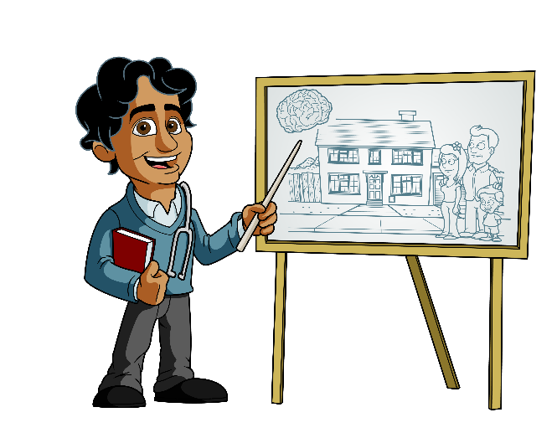
Participate within your comfort zone
1
Ground rules
Respect each
others views
2
Introductions
Consider keeping sensitive information
confidential
3
Enjoy!
4

Slide 3
Primary care
Walk-in centres
Pharmacists
Sexual Health services
School nurses/health visitors
Mental health services
Doctors surgery i.e. GPs, nurses, managers, receptionists

Slide 4
Questions for us…
Why don’t you work in a hospital?
How do you become a doctor?
Do you get embarrassed?
How can I look after my skin?
Can I bring a friend?
Where can I get health information?
How could I book an appointment?

Slide 5
Who knows what confidentiality means?
Green bucket
YES
Red bucket
NO

Slide 6
Would you feel confident to go to a healthcare appointment alone?
Green bucket
YES
Red bucket
NO

Slide 7
How old do you have to be to see a doctor or nurse alone?
12 years?
Any age?
14 years?
16 years?

Slide 8
Mental Health
Minor illness
Body map
Health promotion
Major illness
Notes:
Prompts: Include confidentiality and age.
Carers information.
Self-care.
Mental health top tips.

Slide 9
What is confidentiality?
Same for all ages…
A health professional must not disclose anything learned from a person without that person’s agreement…
We might encourage you to tell someone…
May only be broken where there is risk of harm...

Slide 10
Consent and capacity
Agree to something and understand why it is happening…

Slide 11
Self-care
How can we stay well?
Healthy eating
Exercise
Socialising
Sleeping
Not smoking
Not taking drugs
Avoid alcohol

Slide 12
Support in healthcare
How can we stay well?
NHS choices
Young carers
MIND
NSPCC/Childline
GP practice websites

Slide 13
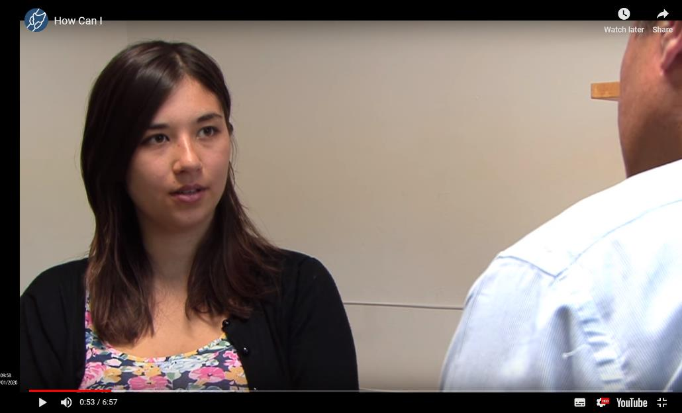
Video
Notes:
https://www.bing.com/videos/search?q=youtube+brighton+and+hove+gp&view=detail&mid=5FD266D698CFA8E00A0C5FD266D698CFA8E00A0C&FORM=VIRE
The video image is hyperlinked. Play the video from 0.28 seconds to 4.05mins

Slide 14
Answers

Slide 15
Who knows what confidentiality means?
Green bucket
YES
Red bucket
NO

Slide 16
Would you feel confident to go to a health care appointment alone?
What could we do to make it easier?
Green bucket
YES
Red bucket
NO

Slide 17
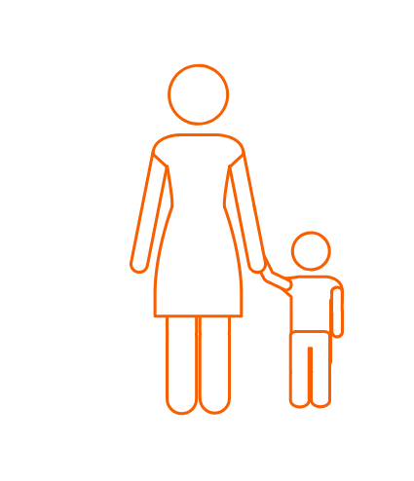
How old do you have to be to see a doctor or nurse alone?
12 years?
Any age?
14 years?
16 years?

Slide 18
Any more questions?

